Slide 1





SHRM October Chapter Meeting
facebook.com/angeloSHRM
angeloshrm.wix.com/home
angeloshrm@gmail.com

Slide 2

Dues
National SHRM Members
  $50 for first long semester
  $25 each semester after
  Send National SHRM ID to angeloshrm@gmail.com
NON National Members
  $100 for first semester
  $50 each semester after
ALL: make sure we have your polo shirt size!

Slide 3
Committee Updates
Professional Development
Community Relations
Recruiting
Communications
Fundraising
Career Development

Slide 4
Community Relations
Christmas at Old Fort Concho – December 5, 6, 7
Concho Valley Regional Food Bank – T/W/TH 11-2
Meals for the Elderly – T/W/TH 11-2
Spread the Cheer – December 2nd
Thanksgiving Food Drive – November
RAM BLITZ – Nov 15
back

Slide 5

SHRM HR Magazine Discussion
“Come On, Get Happy”
Woodward, N. H. (2014). Come on, get happy. HR Magazine, 59(10), 47-52.

Slide 6
Come On, Get Happy!
“Many employers are finding happy workers to be more productive, amicable, and invested in their work.”
Tal Ben-Shahar: happiness is “the overall experience of pleasure and meaning” – e.g. you can experience emotional pain and still be happy
What are some characteristics of a happy employee?

Slide 7
Come On, Get Happy!
Employee engagement and satisfaction often don’t correlate – most people are satisfied, but only 30% of US employees are engaged
Basic needs being met at job makes EE’s satisfied, but engagement/happiness happens when higher-order (think Maslow) needs are met
How can someone be satisfied but not engaged? What about vice-versa?

Slide 8
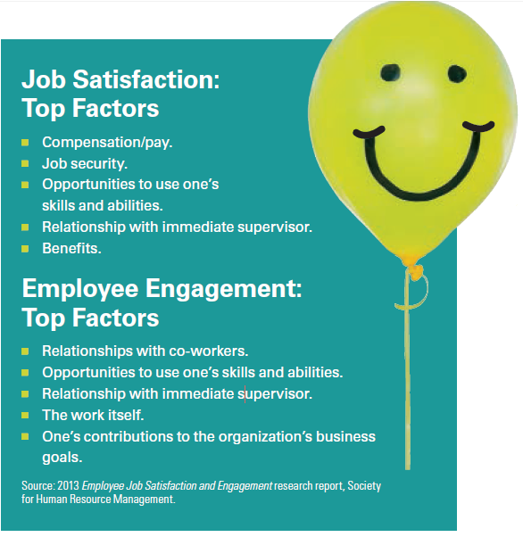
What can employers do to promote employee happiness through engagement?
How would you measure happiness in employees?

Slide 9
Come On, Get Happy!
What makes employees happy is “when they feel they are contributing to something that is important, and they love what they are doing and who they are doing it with.” –Southwest Airlines VP of People, Julie Weber

Slide 10
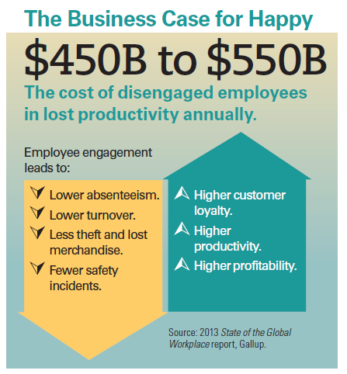

Slide 11
Towers Watson’s 2012
Global Workforce Study
Satisfaction alone will not contribute to increased performance. Workers need:
  Internal support, resources, & tools
  Energizing environment which promotes physical, emotional, and social well-being
What are some ways to implement these strategies?

Slide 12
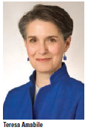
What do employees need?
Sense of progress
Respect, recognition, encouragement, support, affiliation, camaraderie – all important, but less so than progress principle

Slide 13
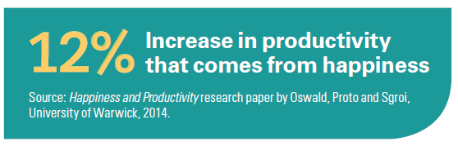
What can employers do?
Help facilitate progress
Provide goals, meaning, and autonomy
Make the most of mistakes
Spread
recognition
Can you think of any companies that focus on these elements to contribute to engagement?
How much of this is the employer’s responsibility?

Slide 14
Join the online discussion!
Join the
angelo state shrm group on linkedin

Slide 15
Next Meeting:
November 20th @ 6 pm!
facebook.com/angeloSHRM
angeloshrm.wix.com/home
angeloshrm@gmail.com

